Slide 1

Connecting Contact Form 7 in Wordpress
Prepared by : Sondagar Tulsi

Slide 2



What is Contact Form 7?
Introduction
Key features
Benefits
Contect form is one of the most popular Form plugin for wordpress.
It helps you to create to manage multiple contact form with ease.
Simple markup for flexible form coustomization.
Support Ajax powered submitting.
Email notification after form submittion.
Easy to use no coding skills required.
Highly coustomizable.
Free and open-source.
Works well with most wordpress theme.

Slide 3
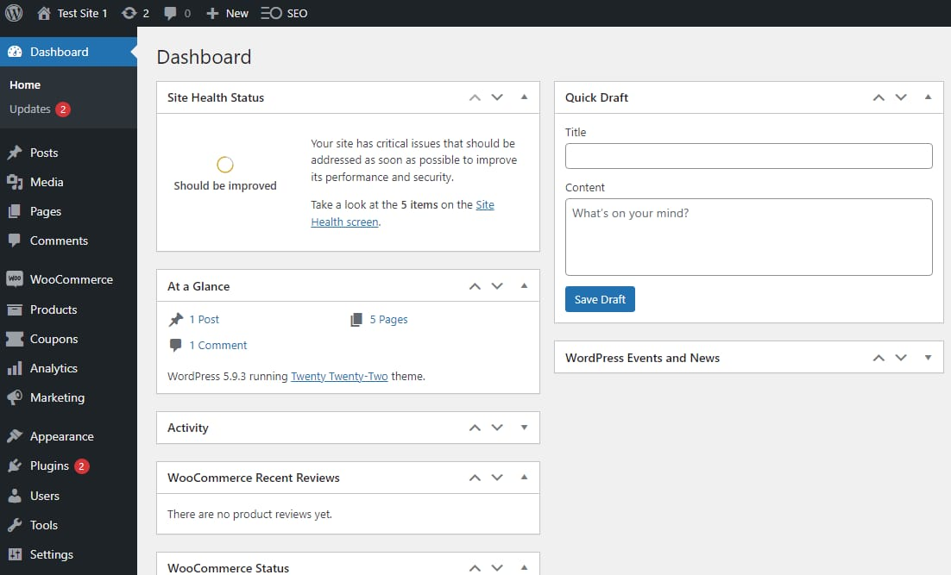
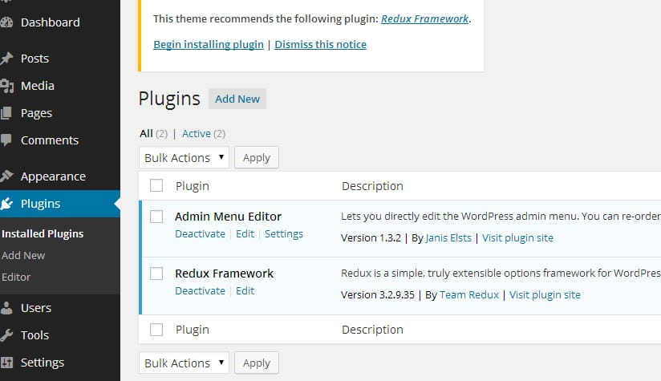
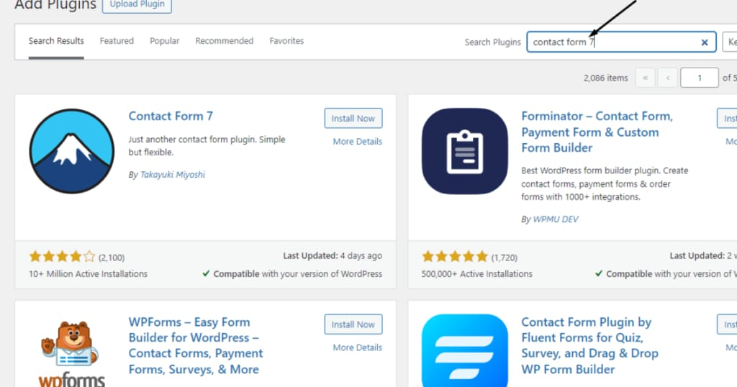
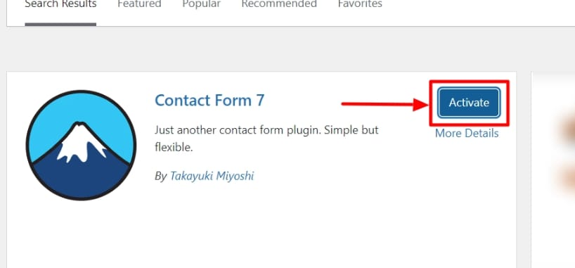

Installation Steps
Integrating Contact Form 7 into your WordPress content is a straightforward process, achievable in just a few steps. Follow this guide to embed your forms seamlessly.
01
02
Login to wordpress dashboard.
Go to Plugins > Add New.
03
04
Search for Contact Form 7.
Click Install Now and then Activate.

Slide 4
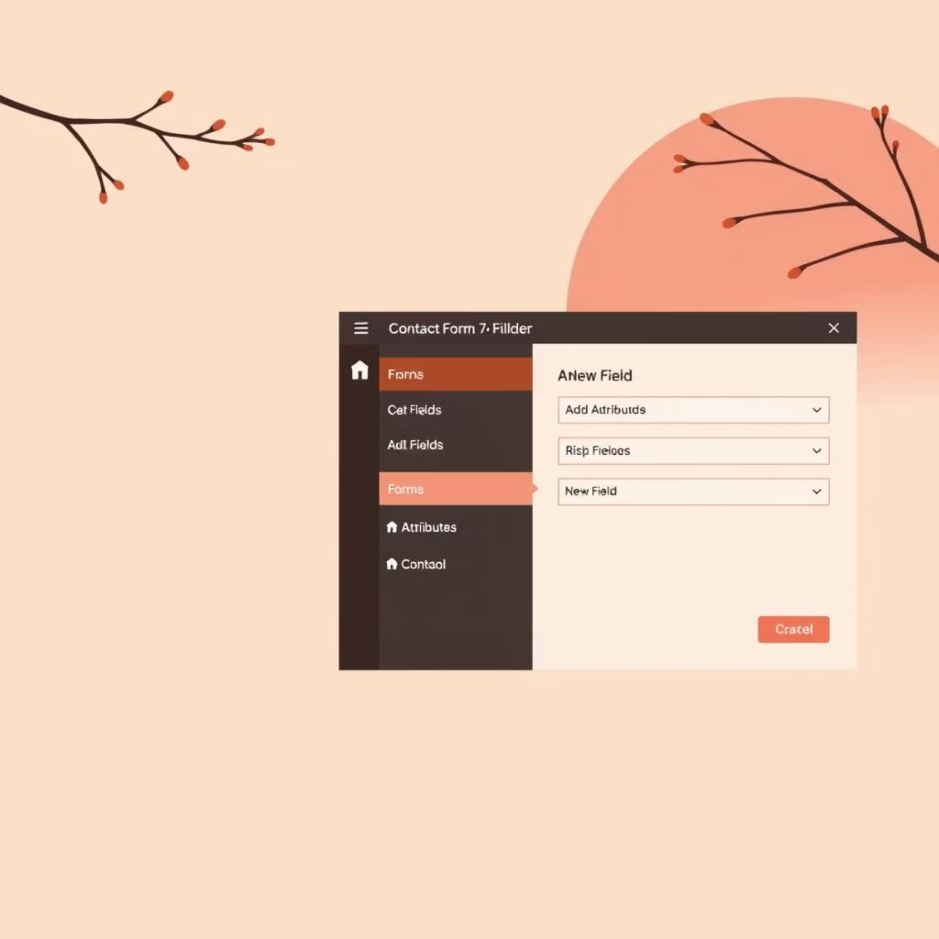
Creating a Contact Form
Unlock the full potential of Contact Form 7 by customising its fields and appearance to perfectly match your website's needs and branding.
1
Navigate to Contact > Add New
2
Customize the form fields using the editor.
3
Save the form
4
Copy the generated shortcode.
Paste the shortcode into any page or post.
By understanding these customisation options, you can create highly functional and visually appealing forms that seamlessly integrate with your WordPress site. Experiment with different field types and styling options to achieve your desired outcome.

Slide 5
Best Practices
Keep forms short and user-friendly.
Enable CAPTCHA to prevent spam.
Test forms regularly.
Use clear labels and placeholders.
Set up autoresponders for better user experience.

